Slide 1

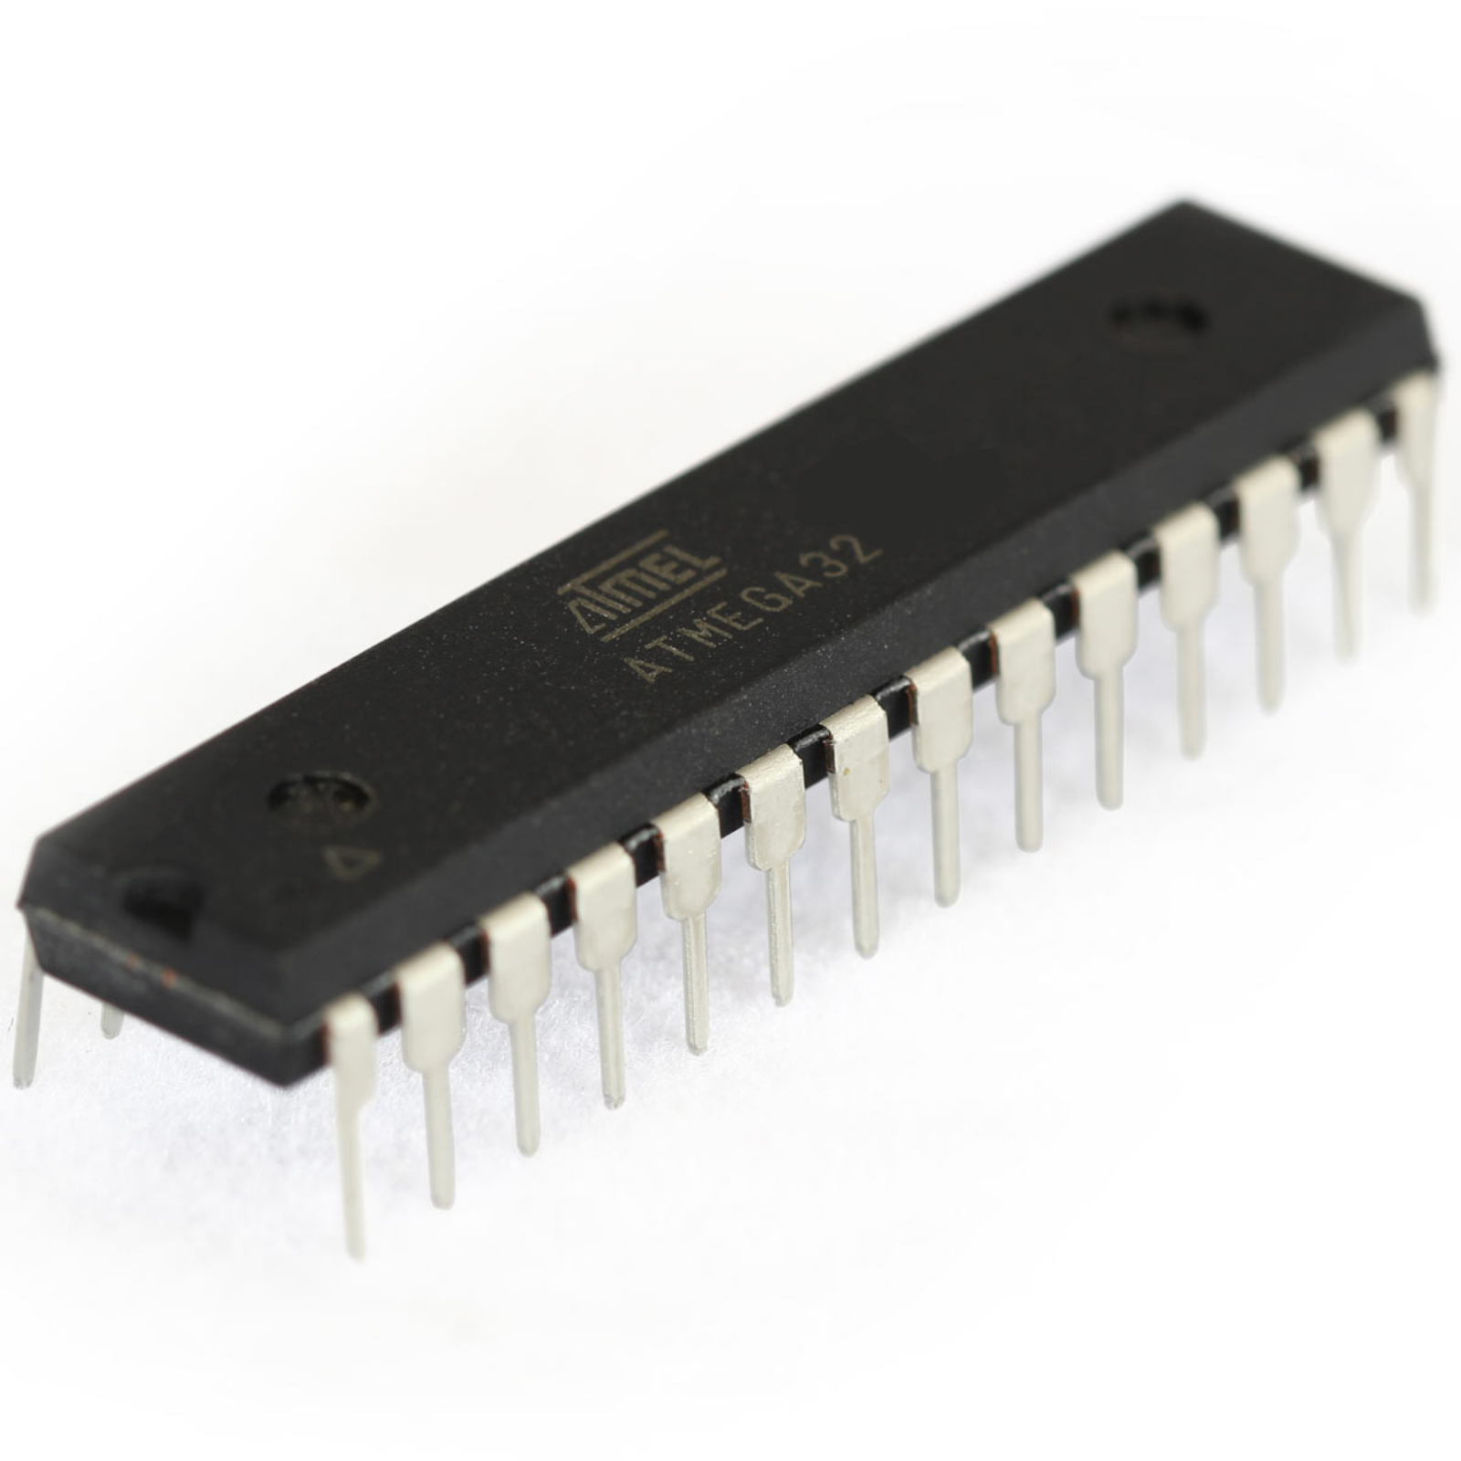

CSE316 Microprocessors, Microcontrollers, and Embedded Systems Sessional
Project Proposal
Group – 39
1705092 – Asif Ajrof
1705093 – Fatima Nawmi

Slide 2
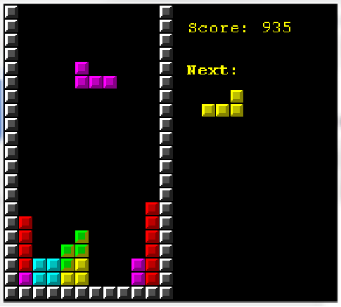
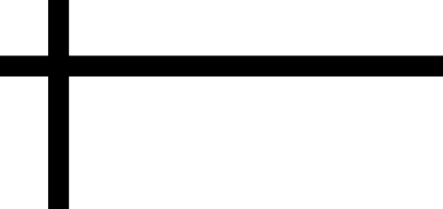

What Are We Making?

Slide 3
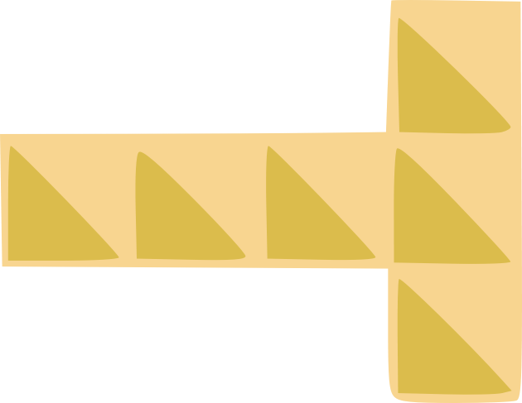
Why TETRIS ?
It will give us a good working knowledge of incorporating multiple components such as LED matrix, LCD screen, Buzzer, Thumb Joystick with Microcontroller.
Implementing the logistics of the game we will learn first hand how to use logistics in real life hardware.
Another reason for choosing this particular game is of course the reminiscence of the popular arcade game that we all played growing up.

Slide 4
How Do We Implement ?
For the game console we will use two LED dot matrices, and another LED dot matrix for showing the next piece.

Slide 5
The Movement
We will use a thumb joystick for movement and rotation of the pieces.
A Tetris piece can be moved left or right to position and down to drop faster with the joystick.

Slide 6
Score
An LCD screen will show the score.
When a row is filled, it disappears and one point is added. If four rows are filled in one move the point is double.
The game finishes when the stack of pieces reach the top.

Slide 7
Sound
For sound effects, a buzzer will be used.
The buzzer will make a beep sound on rotations and row fills.

Slide 8
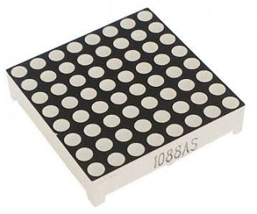
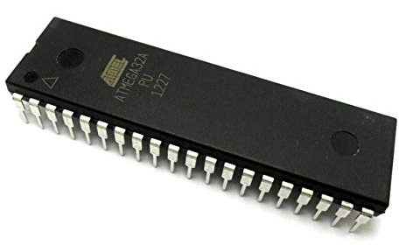
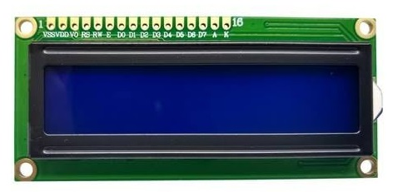
Components
8x8 LED Dot Matrix 2.4’’
Microcontroller ATMEGA32
16x2 LCD Screen

Slide 9
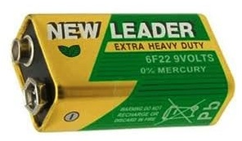
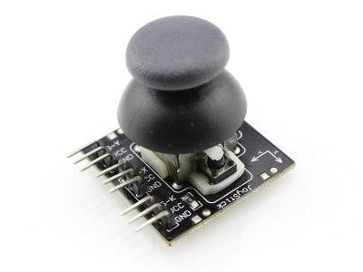
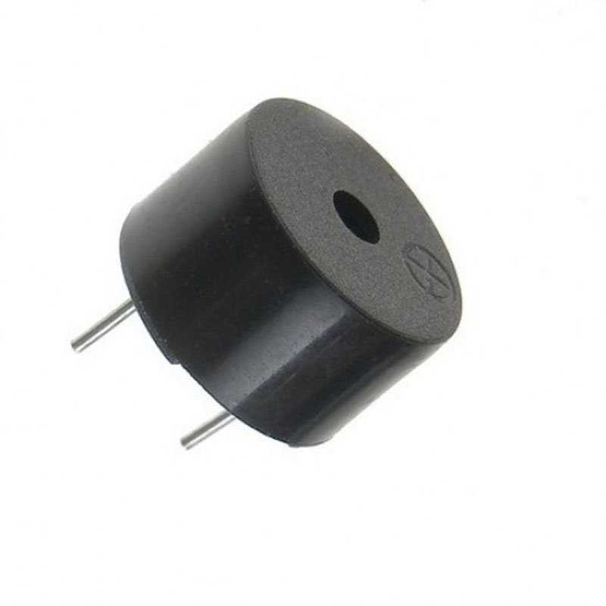
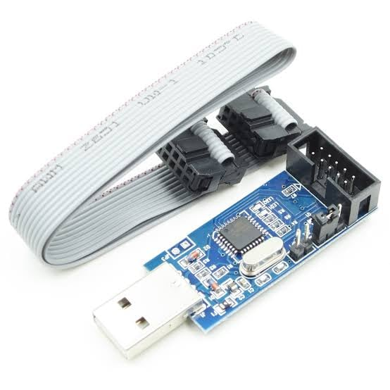
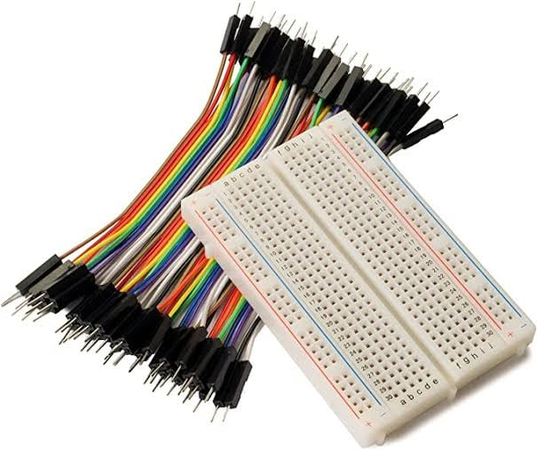
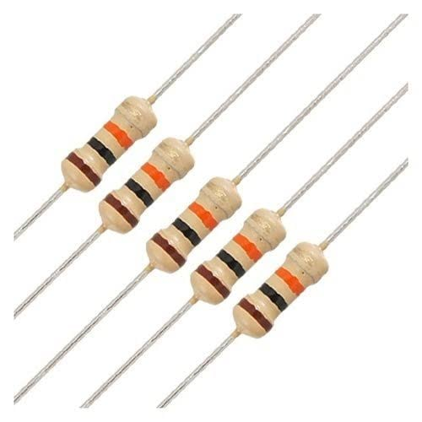
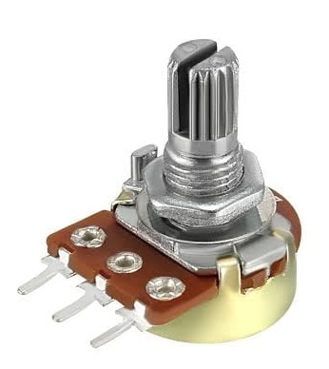
Components
Analog 2-Axis
Thumb Joystick
Buzzer
9V Battery
USBasp Programmer
Breadboard
and Wiring
Resistors
Potentiometer

Slide 10
THANK YOU
1705092 – Asif Ajrof 1705093 – Fatima Nawmi

